Slide 1
Sales & Distribution Overview

Slide 2

Lesson Objectives
Sales and distribution
Purpose
Use
Challenges
Overview of Sales & Distribution
Organization Structure
Master Data
Utilities
Special Process in SD
Integration
Organization Structure Definition
Master Data Details
Utilities
Pricing
Text

Slide 3
Lesson Objectives
Output
Free goods
Cross selling
Material Determination
Listing and Exclusion
Condition Technique
Standard Processes in SD
Inquiry and quotation
Sales order
Delivery
Billing
Tips and Ticks

Slide 4



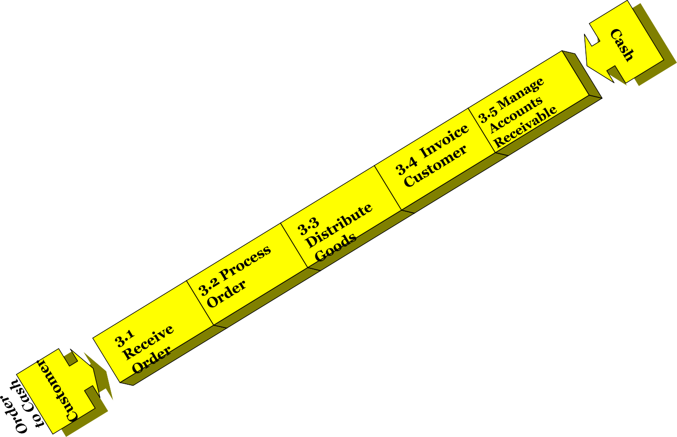
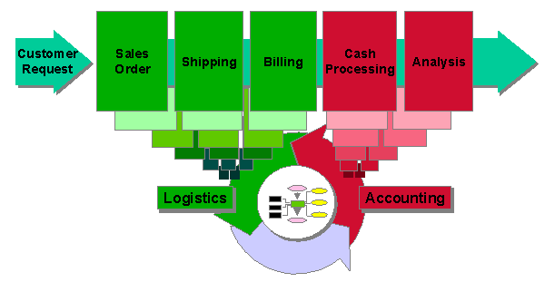
Sales & Distribution
In this course, we will cover 3 main sub-topics which are:
Purpose
Use
Challenges

Slide 5

Sales & Distribution…?
The exchange of goods or services for an amount of money or its equivalent
The process of making the products or services delivered to the customers
Distribution

Slide 6
Purpose
1.
The primary responsibility of the Sales department is to book orders & generate revenue for the Organization.
2.
The employees in a Sales Department interact with the
Customers, answer to their queries, provide them estimates, give
updates on availability of products, based on the buying pattern of the customers offer appropriate products and perform order entry in the system, maintain basic information about the customers and product & services that they consume.
Sales people need to have knowledge about taxation, promotional campaigns, credit & risk management policies, etc.
Products are sold or sent to business partners, or services are performed for them. Information about the products and services, as well as about the customers, is the basis for sales processing
However, in order to deliver the goods to the end customer a lot more information is required. This information includes, but is not limited to, schedule for supplies, packing, transportation and so on.
3.
4.
5.
SD is much more than Sales Orders

Slide 7










Sales & Distribution
Know your customers
Know your Products / Service offerings
Define terms of business
Build utilities
Book Orders
Deliver Goods / Perform services Billing
Get

Slide 8

Use
A customer is a business partner with whom you exchange
Sales order is a contractual agreement between the organization and a customer to deliver products or provide a service for defined prices, quantities and times.
Order
Booking
Terms & Conditions
Information about prices,
taxation, attributes of products &
services
Execution
goods and services
Customer
Interaction
Billing &
Collection
Billing represents the final processing stage for a business transaction
Real time information about availability of products. Shipping is an important part of the logistics chain in which guaranteed customer service and distribution planning support play major roles.
Sales & Distribution people are involved in several activities

Slide 9




Challenges
Who are my customers and where they are?
What do they buy? How much?
What are the open transactions with them?
What is my product range? Is it available? When?
When can it be delivered?
What are the prices? Can I offer any discount? Which promotional offers are on?
What are the taxes and legal requirements?
What is my order booking value for this month? How much is my receivables overdue amount? Which region is showing growth?

Slide 10

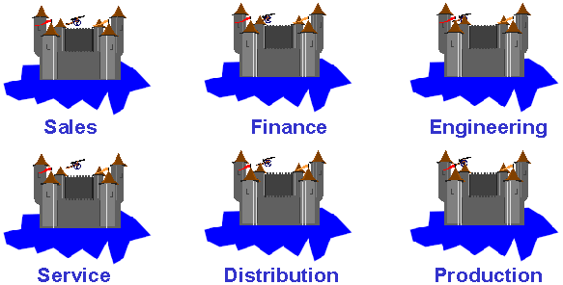
Challenges
Number & value of orders received & processed
Order Entry team
Customer details,
Inquiries, Complaints, Customer
Disputes
Facing team
Data
Management team Prices, Costs, Taxes, Offers, Validity periods
Billing & Collection Team
Prices, Costs, Taxes, Offers, Validity periods
Warehousing & supply
Availability of products Transporters & transportation costs, materials handling & packing
Islands of data

Slide 11







Overview of Sales & Distribution
Integration
Revenue Recognition, Manufacture to Order, Inventory Management
Special Processes
Sale from stock, Consignments, Rejections & returns…
Utilities
Availability Check, Printing,
Taxes, Credit…
Standard Processes
Opportunities, Sales,
Shipping, Billing
Organization Structure
Organizational structure is the way in which the interrelated groups of an organization are constructed
Master Data
Data which is used long-term in SAP System for several business processes. For example Customers, Materials, Prices

Slide 12


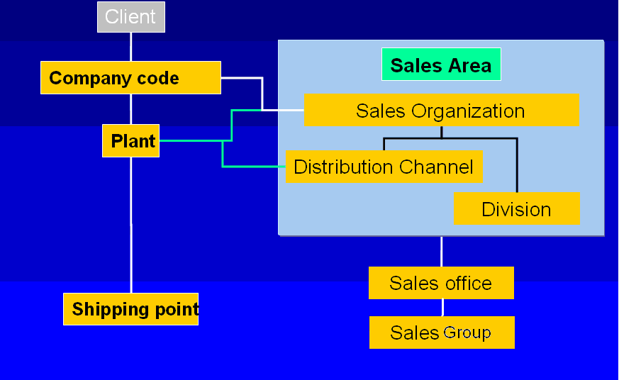

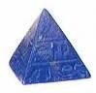




Organization Structure
Accounting
& legal
Independent Accounting Units that are legally Independent from each Other.
Sales & shipping
Factory & warehousing
To monitor the stock of material it is necessary to be able to store in the system the locations at which materials are kept.
Selling units responsible for Sale & distribution of goods
& services for specified distribution
Chains & collection of products

Slide 13

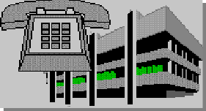
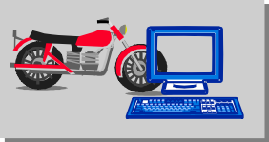
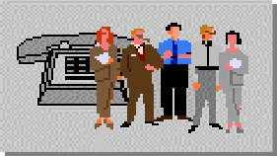
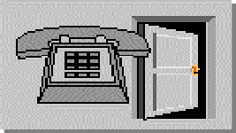
Organization Structure
•
In the SAP R/3 System the legal and organizational structure of your company is represented. You can also structure from the point of view of accounting, manufacturing & inventory , and sales and distribution.
Distribution Channel
Sales
organization
Division
0001
01
01
Sales Area
Sales Office
Sales Group
•
An enterprise structure is mapped to SAP applications using organizational units. Organizational units handle specific business functions.

Slide 14



Master Data
Customers
A company has contact with its business partners, who are customers & contact persons. Data on each of these and on the company's personnel is stored in a separate master record.
Customer-Material
Materials
Info Record
Products combined System material. necessary
and services are
R/3 term
Data on a material defined for
in the SAP
the
Master Data
one specific customer is stored in the customer material information records. If one of your customers
under All
information for the
management of a material and its stocks, as well as its use, is maintained in the so-called material master record. This includes, for example, data on purchasing, on sales and on storage.
uses a number for a material,
which differs from the number your company uses to identify it, you can store the material number used by the customer in the customer material information record.

Slide 15




Utilities
The most important SD basic functions are:
Pricing
The condition technique refers to the method by which the system determines prices from information stored in condition records. Various elements used in the condition technique are set up and controlled in Customizing. During sales order processing, the system uses the condition technique to determine a variety of important pricing information.
Text Processing
In a business relationship, it is essential that business partners exchange
information throughout the logistics chain. In sales and distribution, this exchange of information is supported by texts in master records and documents. You can maintain these texts for Customer or Material Masters or define them so that they can be used more flexibly. Example: Sales Notes for Customers, Shipping Instructions in Deliveries
Output Determination
The Output Determination component offers output functions for sales, shipping, transportation, and billing to help you manage sales transactions with your customers and within your company. Output types are used to represent various forms of output in the SAP system.
Examples of output types in Sales and Distribution processing are order confirmations, freight lists, and invoices.

Slide 16






Utilities Important SD basic functions continued…….:
Free Goods | If you grant free goods to a customer, you can implement automatic free goods determination. The system automatically create a free goods item in the sales order. The item is free of charge. For inclusive free goods, the main item is automatically reduced by the free goods quantity. For exclusive free goods, the quantity of the main item remains the same, and customer receives additional pieces as an additional free of charge item.
Material Determination | In the standard order processing cycle, a customer requests a specific product that you then ship. In reality, however, there are situations where you want to substitute the product ordered with an alternative, for example a product that is repackaged for Christmas, or with a free sample or coupon. Material determination uses condition technique to automatically swap one material for another in the sales order, when certain conditions apply.
Cross Selling | Retailers frequently use cross selling to increase sales. When a customer orders an article over the phone, the order taker can suggest additional articles that the customer might buy. For example, if the customer orders a VCR, you might suggest purchasing some blank tapes; for a cellular phone, a leather carrying case. Dynamic product proposal allows you to automatically propose additional items to a specific customer from a list of products during sales document processing.
Material Listing and Exclusion | Material listing and exclusion lets you control which materials specific customers may or may not buy. For example, if you create a material listing for a specific customer, the customer can only order products from that list. You can also create a master record for material exclusion for a particular customer. Then the customer can not order excluded materials from you.

Slide 17
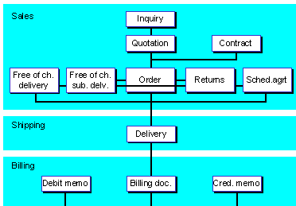
Standard Processes in SD
The customer may later place an order and you create a sales order with reference to the quotation. You ship the goods by creating a delivery.
The customer is billed by creating and Invoice referring to the delivery document.
A customer’s inquiry (even if telephonic) is created in the system.
If the customer requests a quotation, it can be created by referring to the inquiry.
After delivery, the customer claims credit for damaged goods and you create a free-of- charge delivery with reference to the sales order.

Slide 18
Standard Processes in SD
It is possible to create a Sales Order by referring to a Quotation or also as an independent document. When you create Sales Order with reference to an existing Quotation, the system automatically copies all the relevant information (customer info, materials, quantities, etc) from Quotation to a Sales Order.
Where necessary, a reference to a preceding document can be set as mandatory. For example, you may specify that Returns Order should always be created with reference to an existing Sales Order, etc.
Customer complaints about damaged products can be handled through subsequent free delivery or also via a Credit Memo.
The entire chain of documents – the inquiry, the quotation, the sales order, the delivery, the invoice, and the subsequent delivery free of charge – creates a document flow or history.

Slide 19


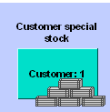
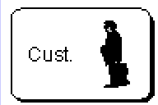
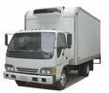
Special Process in SD
Consignment Fill Up
PO
Sales Order
Pur Req
Pur Order
Delivery
Goods Issue
1
1
2
3
4
Goods
PO with Vendor
6
Consignment Fill Up
Billing Document
Vendor Invoice⁵
Billing
Delivery
Goods Issue
MM Invoice
2
8 Invoice to Customer
Qty
Consignment: Customers store the consignment goods at their own warehouses. The customer can access the goods in the consignment warehouse at any time. They are only billed for the goods when they are removed from the warehouse and only for the actual quantities taken from the warehouse.
Third Party: You may need to let a vendor deliver items you would normally deliver yourself. You pass the order along to a third-party vendor who then ships the goods directly to the customer and bills you. You then create an Invoice for the customer based on the quantity billed to you by the vendor

Slide 20
Special Process in SD
Make-to-order production is a process in which a product is individually manufactured for a particular customer. In make-to-order production a material is created only once though the same or a similar production process might be repeated at a later time.
Rush Order document type ensures that Delivery is created automatically in background. This is relevant where customer picks up the goods directly. Once the billing documents are created, invoice papers are printed and sent to the customer.
Configurable materials in Sales Documents are complex products that can produced in different variants. For example, cars have different paintwork, upholstery and different-sized engines. You can configure a product depending on the Customer’s requirement.
Returnable packaging consists of materials that are stored at the customer location but which remain the property of your company. The customer is only required to pay you for the returnable packaging if he does not return it to you by a specified time, for example pallets.

Slide 21




Integration
Sales Support
Materials Management Production Planning Controlling
Financial Accounting
MM
PP
Sales
FI
CO
Shipping
MM
Master Data
Materials Management
Financial Accounting
FI
Billing
FI
Financial Accounting Controlling
CO

Slide 22








Integration with FI
Billing data in invoices, credit and debit memos is forwarded to Financial Accounting. When you create a billing document, the system automatically creates all relevant accounting documents for:
General Ledger
Controlling and Profitability Analysis (CO/PA)
Profit Centre Accounting
Accounting
Other important areas of integration with FI are:
Credit Management | Credit Management enables you to minimize the credit risk by specifying a specific credit limit for your customers. Thus you can take the financial pulse of a customer and enhance your credit-related decision-making. You can specify at which critical points (for example order entry, delivery, goods issue) the system carries out these credit checks
Intercompany Billing | A sales organization creates a sales order for ordering goods from a plant assigned to another company code. The plant in the delivering company code delivers the goods to the customer. Because the two companies balance their accounts independently, the delivering company must bill the ordering company for the goods.
Down Payment | Down payments are payments made before completion of the product, with no interest. Normally, down payment agreements are made for producing and delivering goods to customers in the capital goods, or plant engineering and construction industries.
Account Determination | Revenue Account Determination is a process by which Accounts to which prices, discounts and surcharges are posted.

Slide 23






Integration MM & PP
Material requirements planning is informed of quantities which sales and distribution require to be able to deliver orders received. If sufficient quantities are not available to cover the requirements, purchase requisitions and orders, for example, can be created in Purchasing on the basis of transfer of requirements within automatic planning.
Availability Check & Transfer of Requirements | When you enter a sales order, you can only confirm the delivery of the goods for the required delivery date if the goods are available for all the necessary processing activities which take place before delivery. The shipping department must ensure that freight forwarding or another shipping company is advised early enough so that sufficient time remains for packing and loading to be carried out. An availability check can be carried out on the deadline date for availability for the goods. The procurement department must ensure that the production and purchasing departments are advised of inadequate stock quantities so that goods can either be produced punctually or ordered.
Goods movement is a transaction resulting in a change in stock. When posting a goods movement in the SAP System, a Material Document & Accounting document are created.
Goods Movements | A document must be generated and stored in the system for every transaction/event that causes a change in stock. For example, Issue of goods to customer for sale or for Consignment has different implications on stocks & cost, which is controlled via Movement Types.

Slide 24
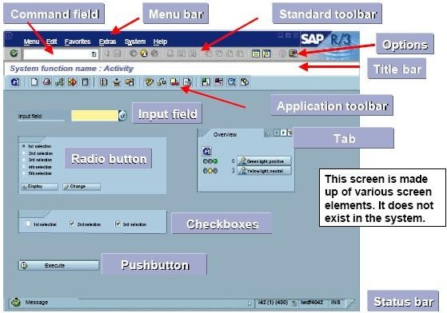
SAP Screen Elements

Slide 25






Organisational Structure - Definition
Organisational Structure consists of the following:
Company Code is the smallest organizational unit of external
accounting for which a complete, self-contained set of accounts can be created. Company Code forms the top of the sales and distribution chain, and its definition is mandatory.
Balance Sheet
Sales Organisation is responsible for the sale and distribution of goods and services, and represents the selling unit as a legal entity. It is also responsible for product liability and other rights of recourse. It is highest organizational unit within Logistics.
Sales Organization can be assigned to exactly one Company Code.
Distribution Channel represents the channel through which sellable materials or services reach customers (e.g. retail, wholesale, direct, e-commerce, etc)
Division is a collection of Product groups. A material belongs to exactly one division only.

Slide 26




Organisational Structure - Definition
Sales Area is the combination of a distribution chain (a sales organization and a distribution channel) and a division.
Sales Organisation
Sales Office is an organizational unit in sales and distribution which is responsible for sales within a specific geographical area.
A sales office can be assigned to one or more distribution chains.
Distribution Channel
Division
Sales Group is the staff of a Sales office

Slide 27

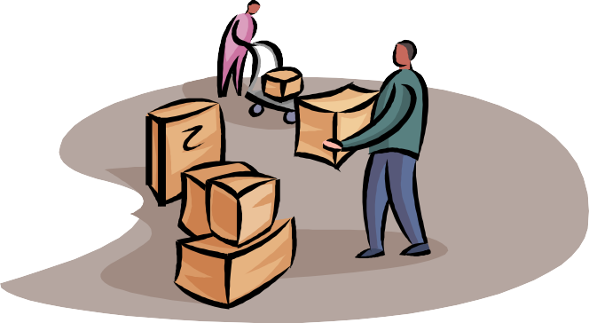
Organisational Structure - Definition
Plant is a place where materials are produced or stored, or goods and services are provided
Shipping Point is responsible for scheduling, processing and monitoring of inbound & outbound deliveries, as well as for carrying out goods issue.

Slide 28

Organisational Structure - Assignment
Organisational Units defined in Sales and Distribution Module need to be logically assigned to one another to form a proper hierarchy.
Rules for Assignment:
One or more Sales Organisations can be assigned to a Company Code but each Sales Organization belongs to one & only one company code.
One or more Plant can be assigned to a Company Code but each Plant belongs to one & only one company code.
One or more combination of Sales Organisation and Distributional Channel can be assigned to a Plant.
If the Plant and Sales Organization belong to different company codes then the Sales transaction is categorized as Inter-company
One or more Shipping Points can be assigned to a Plant. Similarly, one or more Plants can be assigned to a Shipping Point.

Slide 29
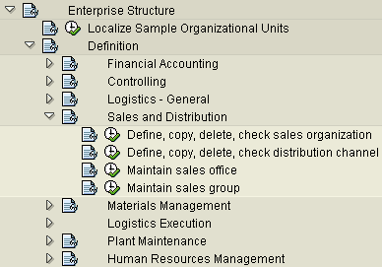
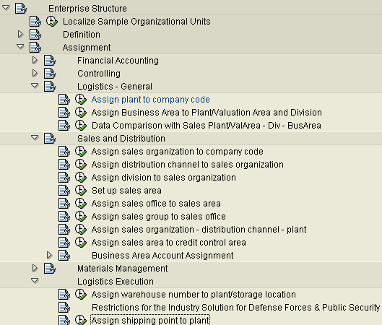
Organisational Structure - Example
Define Assign
Menu Path for Configuration:
Display IMG→ Enterprise Structure→ Definition→ Sales and Distribution Display IMG→ Enterprise Structure→ Assignment → Sales and Distribution

Slide 30


















Master Data – Material Master
Basic Data
Calssi fication
Material Planning
Same Material can be used by different Departments, hence material has many Views.
Forecast
Stock Plant/Sloc
Material Master has Main Views (Basic Data, MRP, Purch. Org, Sales) and Additional Views (UOM, Text, etc)
Quality
Material Master
Accounting
In Material Master some views are maintained at Client Level, whereas the others are maintained at other organizational levels, e.g. Plant, Sales Organization/Distribution Channels level, etc.
Work Schedule
Storage
S&D
Ware house
Purchasing
The data in Material Masters is either descriptive (description, etc.), or can control certain functions (material group, procurement key, etc.).
Material Master
Additional Data
Text
UOM
Addition EAN
Document Data
Consumption
Material Master has approximately 800 fields.

Slide 31

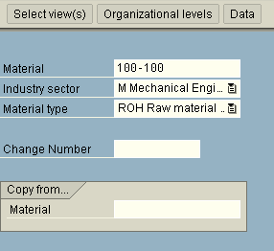
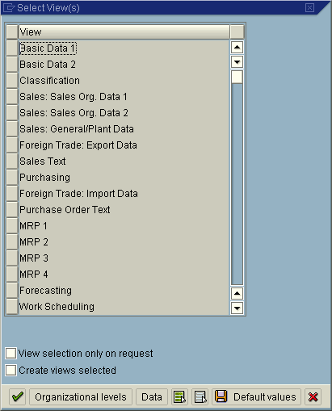
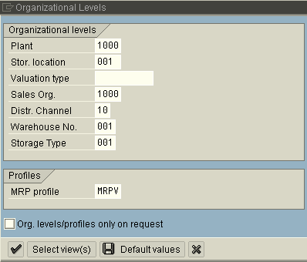
Master Data – Material Master

Slide 32
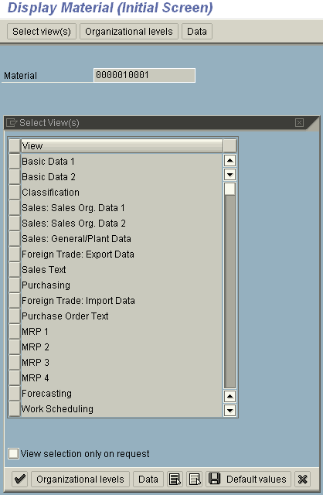
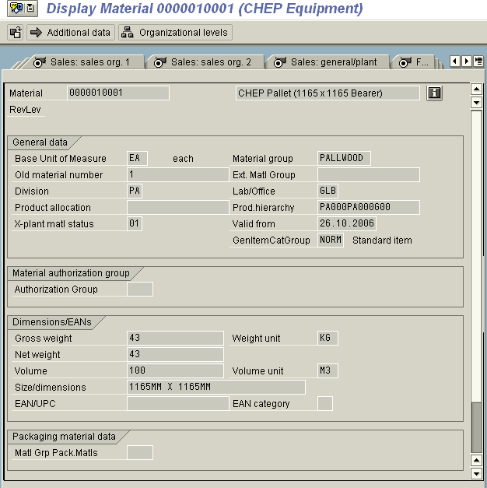
Master Data – Material Master
Transactions,
MM01 - Create Material MM03 - Display Material
MM02 - Change Material
MM06 - Flag Material for Deletion
MM17 – Mass Maintenance of Material

Slide 33
Master Data – Material Master
Material Type is an SAP way of grouping materials with same basic attributes.
DIEN | Services | LEIH | Returnable packaging
FERT | Finished products | NLAG | Non-stock materials
HALB | Semifinished products | ROH | Raw materials
HAWA | Trading goods | UNBW | Nonvaluated materials
KMAT | Configurable materials | VERP | Packaging
Material Type controls:
Whether the material number can be assigned internally or externally
Which screens appear and in what sequence
Which fields are mandatory, optional, display only, or suppressed on each of these screens.
Default values for certain fields such as procurement type & Item Category group
Value and/or Quantity update requirement for a material
Logistics General →Material Master →Basic Settings →Material Types

Slide 34










Master Data – Customer Master
CUSTOMER MASTER
General
Data
Sales Area Data
Company Code Data
Data on the client level can be used by all company codes

Slide 35


Master Data – Customer Master
General Data
Company Code
Data
Sales Area Data
Address
Account Management
Sales
Control Data
Payment Transactions
Shipping
Marketing
Correspondence
Billing
Insurance
Payment Transactions
Partner functions
Unloading Points
Contact Person

Slide 36
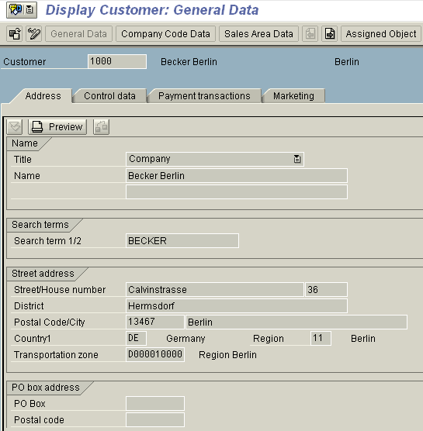
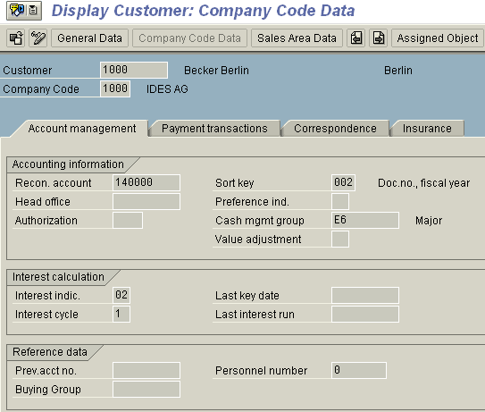
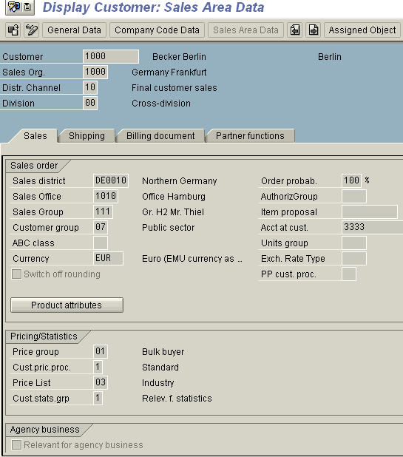
Master Data – Customer Master
Transactions,
XD01 - Create Customer (complete) VD01 – Create Customer ( S&D) FD01 – Create Customer ( FI)
XD02 - Change Customer (complete) VD02 - Change Customer (S&D) FD02 - Change Customer (FI)
XD03 - Display Customer (complete) VD03 - Display Customer (S&D) FD03 - Display Customer (FI)
VD05 - Block Customer

Slide 37
















Master Data – Customer Master
Account Group is a classification of customer master record
Sold-to Party Ship-to Party
Customer
Bill-to Party
Payer
Account Group controls,
Which fields in the master record are required or optional
Number range for the customer account number (external or internal)
Whether it is one-time account
Default value for pricing procedure indicator
Logistics General →Business Partner →Customers →Control

Slide 38
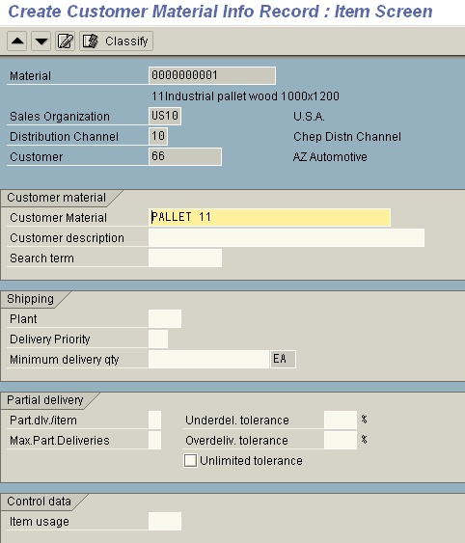
Master Data – Customer Material info
If the customer uses a different identifier than the one the business uses for the material, this can be included in a customer material information
Uniquely identifies the material from the customer's point of view
Customer material info can also include shipping specific data like plant, delivery tolerances, partial delivery details etc
The user can simplify the data entry process by using a customer-material info record during sales processing
VD51 – Create VD52 – Change VD53 - Disply

Slide 39



Utilities – Pricing
Pricing Elements
Prices
Discount /
Surcharges
Freight
Taxes
Material Price, Customer Price
Material Group Discount, Material Discount
Incoterms part1
Taxes
Condition Types
PR00 - Price
K029 – Material Group discount K004 – Material discount
KF00 - Freight
MWST – Output tax
All of the pricing elements that you use in your day-to-day pricing procedures - the prices, surcharges, discounts, freight charges, and taxes - are defined in the R/3 system as condition types.
During sales order entry, the system can calculate prices automatically by finding a gross price, deducting all the relevant discounts and adding any surcharges such as freight and sales tax.
Depending on the pricing policies of your company, you may be able to change prices manually during sales order processing. You may, for example, be able to enter or change certain discounts within a specified range.

Slide 40
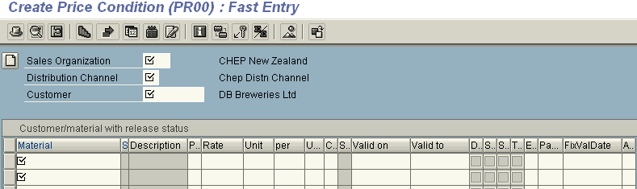
Utilities – Pricing
Pricing is a broad term to describe the calculation of prices. The pricing conditions include:
Price
Freight
Discount / surcharge
Taxes
In SAP a data record that stores a condition is called condition record (pricing condition record in case of Pricing).
Pricing condition records can be maintained at any level, e.g. customer, material, customer/material, material group, customer group
Pricing condition records will have validity periods, upper & lower limits
and also scales

Slide 41




Utilities – Texts
Customer Master
Central Texts
Financial Accounting Texts
Sales & Distribution Texts
Contact Person Texts
Material Master
Basic Texts
Sales Texts
Purchase Texts
Customer Material
Info
Customer – material Texts
Sales order
----------
----------
Header Texts
Item Texts

Slide 42

Utilities – Text
Document (sales / delivery / Billing)
Master Data
Header
Item
•Header Text
•Header notice
•Shipping requirements
•Material Sales text
•Packing note
•Shipping requirements
Customer Master Central Texts S&D texts
Contact person texts
Material Master Basic texts Sales text
PO Text
Customer Material
info’
Info Record texts
•Contractual requirements
Texts are proposed from the master records in the sales and distribution documents, if you have made the appropriate setting.
You can integrate standard texts into the sales and distribution documents.
Texts can be copied from a reference sales and distribution document into another sales and distribution document (e.g. from an inquiry into a sales order or from an order into a delivery).
The copying of texts can be made language dependent, if required.
You can change copied texts
In a Sales Document Texts can be maintained as Header or Item Text

Slide 43
Utilities – Output
Output types are used to represent various forms of output in the SAP system. Examples of output types in Sales and Distribution processing are order confirmations, pick lists, packing slips, and invoices.
You can also choose Extras → Output → Header or Item → Print Preview on the overview screen of the sales document.
You can send output documents more than once. This can be useful if, for example, there are technical or other problems when you print an output document the first time.
Outputs can be produced using different media – print, fax, email, EDI, etc.

Slide 44


Utilities – Output Determination
Output Master data
Sales order
Output type: Order confirmation Transmission: Print
Partner Function: SP 1000 Time: Immediately Language: EN
Output type: Partner Function Transmission Medium
Time Language
Output determination
PRINT
Order Confirmation
-- - - - -
-- - - - -

Slide 45




Utilities – Free Goods
Inclusive | The customer only pays for some of the goods requested. The rest of the goods are free of charge. Two out of eight eggs are free goods. Therefore, if you order 8 eggs, 8 will be delivered and you will not be charged for 2 of them. So in this case, you have ordered an inclusive bonus quantity. | 2 out of 8
Exclusive | The customer pays for the goods ordered and is given extra goods free of charge. The exclusive bonus quantity is also called exclusive free goods and means that in addition to the purchase order, a certain quantity of materials are guaranteed as free goods. In other words, a larger quantity is delivered than is ordered, whereby no charge is made for the additional quantity delivered. | 3 + 1
Exclusive different material | The materials delivered as free goods do not necessarily have to be the same as the materials orders. When a customer orders 3 large trays of eggs, the customer would be offered a chicken for free! | 3 + 1
•The free goods quantity can be defined as a quantity proportional to the sold quantity.
•For the delivery you can control whether the free goods are processed independently or whether they are only copied to the delivery for partial delivery or full delivery.

Slide 46
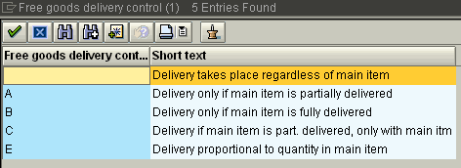
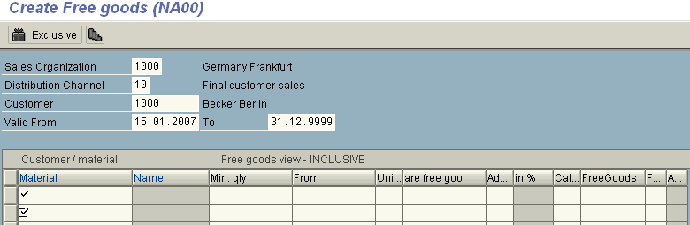
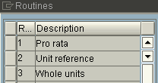
Utilities – Free Goods
Screen display
VBN1 – Create Free goods VBN2 – Change Free goods VBN3 – Display Free goods

Slide 47


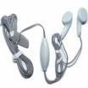
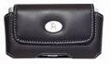
Utilities – Cross Selling
+
+
+
You can set up the system so that if a customer orders a specific article, a list of other suggested articles appears as well.
Cross selling articles can be delivered independently of their corresponding main articles in the sales order, or the cross selling articles can only be shipped either together with or after the main articles have been shipped.

Slide 48
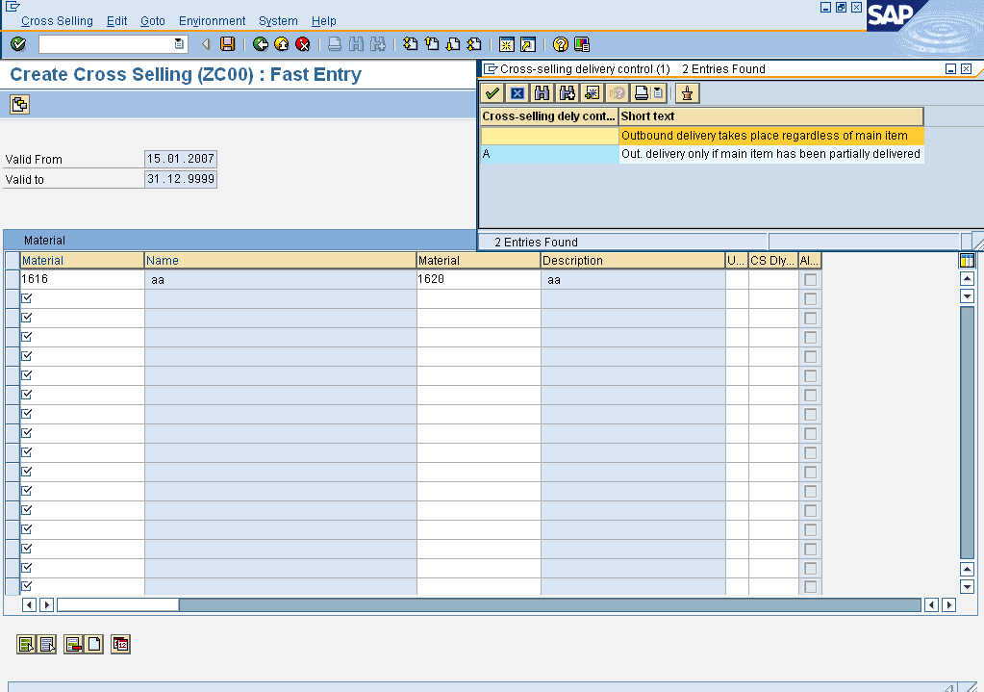
Utilities – Cross Selling
VB41 – Create Cross Selling VB42 – Change Cross Selling VB43 – Display Cross Selling
You can set up the system so that if a customer orders a specific article, a list of other suggested articles appears as well.

Slide 49

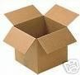

Utilities – Material Determination
→
Material determination enables the automatic substitution of materials
in sales documents during sales order processing.
•You may wish to use Material Determination for:
Replacing a standard product with the one with promotional packing
Substituting discontinued materials with newer materials
When you enter a material in a sales order, the system checks whether you have set up product selection for this material. If so, it creates a list of possible alternatives, checking each to determine current stock availability, and whether the customer would accept it based on the product attributes.
For each valid substitute that if finds, the system creates a sub-item.
•The system can re-determine product substitutions when copying them
from sales order to deliveries (optional).

Slide 50
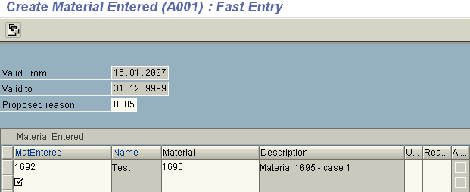
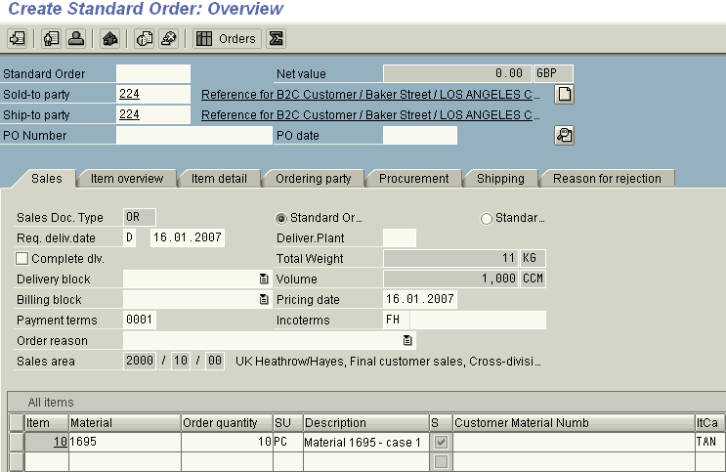
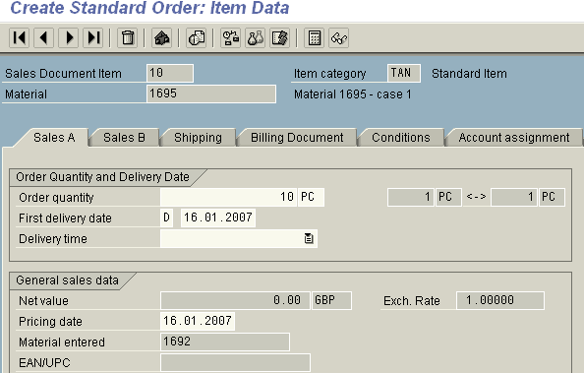
Utilities – Material Determination
Condition record
Material Determination
Material Entered
Substitute
Material
Sales Order
VB11 – Create Material determination VB12 – Change Material determination VB13 – Display Material determination

Slide 51

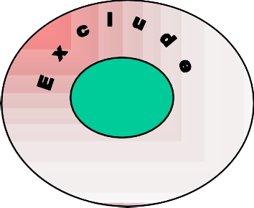
Utilities – Listing & Exclusion
List
Material listing lists which materials a customer can buy.
Material exclusion lists which materials a customer cannot buy
Material listing applies to two partner functions in Sales & Distribution:
the sold-to party and the payer.
when the sold-to party and payer are different, the material listing check is as follows:
If the sold-to party has a material listing, the system only checks this listing (no other check takes place).
If there is no listing for the sold-to party, but a listing has been created for the payer, the system automatically checks the payer’s listing.
If no material listing data exists for either the sold-to party or payer, then the customer may order any material

Slide 52






Utilities – Listing & Exclusion
Master data for Material Listing Master data for Material Exclusion
Sold-to party: C1 Item: M1
M2 M3
Sold-to party: C1 Item: M1
M2 M3
M$
Customer : C1 Material: M1, M2
Customer : C2 Material: M3, M4
VB01 – Create Listing / Exclusion
VB03 – Display Listing / Exclusion
VB02 – Change Listing / Exclusion

Slide 53

Condition Technique
Pricing is automatically determined during sales processing. SAP’s Condition Technique method helps in doing this.
Pricing Procedure
1.
2.
3.
4.
The condition technique includes condition tables, access sequence, condition type & procedure
Sales Order
PR00 K004 KF00 MWST
Price Discount Freight Output tax
PR00 $ 10
--------------
--------------
Condition type is a characteristic of a condition (e.g. price, tax, discount, etc.)
Condition Type Access Sequence Condition Tables
PR00 PR02
Condition tables contain key fields for which conditions records are created
Access sequence defines the order in which the system searches for condition records. The access sequence consists of one or more accesses.
Customer/ Material
Customer group/Material
Customer/Material group
Condition record PR00
Pricing Procedure (also known as Calculation Schema in some SAP
solutions) defines the conditions permitted and the sequence in which the system takes these conditions into account during sales processing
Valid record found

Slide 54
Condition Technique (Cont-d)
The sequence of activities in configuring Pricing using Condition Technique is generally as follows:
1) Define the condition tables that enable you to store and retrieve condition records for each of the different condition types.
Sales and Distribution - >Basic Functions ->Pricing -> Pricing Control ->Define Condition Tables ->Create Condition TableT-Code V/03
2) Define the access sequences that enable the system to find valid condition records.
Sales and Distribution - >Basic Functions ->Pricing -> Pricing Control ->Define Access Sequences->Maintain Access SequencesT-Code V/07
3) Define condition types for each of the price elements (prices, discounts, and surcharges) that occur in your daily business transactions.
Sales and Distribution - >Basic Functions ->Pricing -> Pricing Control ->Define Condition
Types->Maintain Condition TypesT-Code V/06
4) Group condition types and establish their sequence in pricing procedures.
Sales and Distribution - >Basic Functions ->Pricing -> Pricing Control ->Define and Assign Pricing Procedure ->Maintain Pricing ProcedureT-Code V/08
5) Create Pricing Condition Records
SAP Easy Access -> Logistics->Sales and Distribution->Master Data->Conditions Select Using Condition Type -> CreateT-Code VK11

Slide 55
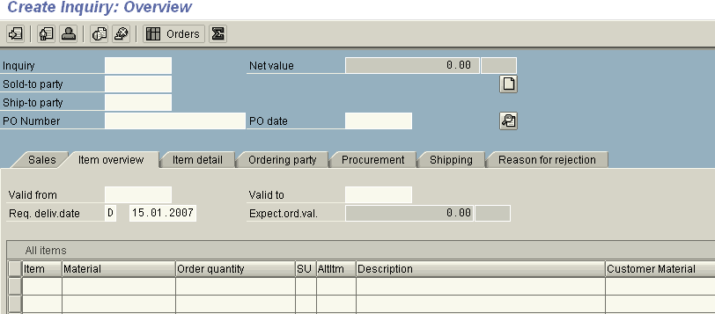
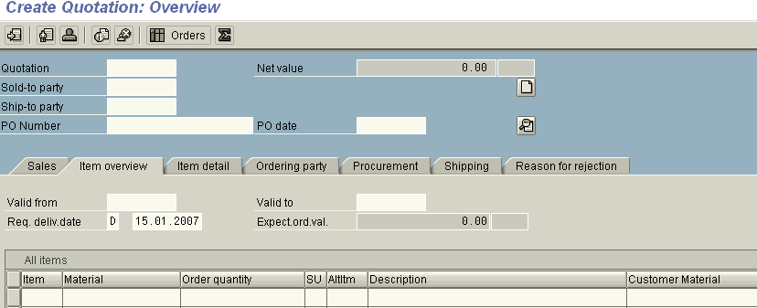
Sales Process – Inquiry & Quotation
A Document Type determines a type of sales transaction, e.g. Quotation or Order.
The Header data contain details of sold-to party, validity dates, required delivery date. Item data will have details about material and required quantities. Schedule line data contains quantities and delivery dates
VA11 – Create Inquiry VA12 – Change Inquiry VA13 – Display Inquiry
A Quotation is created with or without reference to an Inquiry. If referred to an Inquiry, the data is copied from inquiry to the quotation. The validity dates & delivery dates can be re determined.
VA21 – Create Inquiry VA22 – Change Inquiry VA23 – Display Inquiry

Slide 56












Sales Process - Sales
Data sources for sales order
Delivery Scheduling
Master Data
Eg: Customer master, Material Master
Transfer of Requirement
Availability Check
Existing document
Eg: sales order
Sales order
Text
Sales Document
Pricing
Customizing
Eg: sales document type, delivery block
Output
Sales Info’ System
Credit Check
Hard-coded controls
Eg: ABAP programs
A sales order is created with / without reference to a preceding ( inquiry / quotation / order) document. If referred, the data is copied from the preceding document
The data in a sales document is distributed among header, item and schedule line levels
To process the sales documents efficiently the data can be displayed & processed in different views. The views are grouped in to Overview, Header & Item screens
The important functions like plant determination, pricing, availability check, delivery scheduling, credit check are carried out automatically depending upon the settings that are done

Slide 57
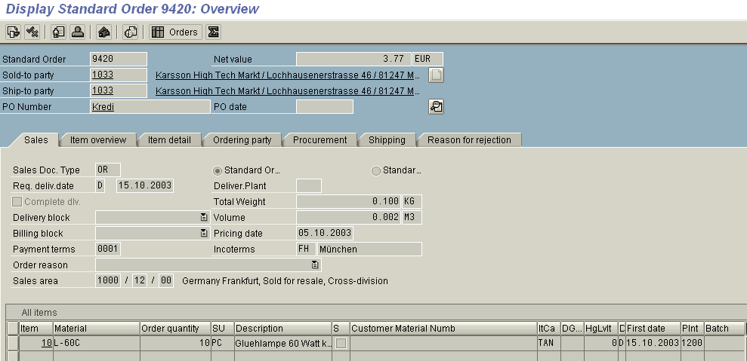
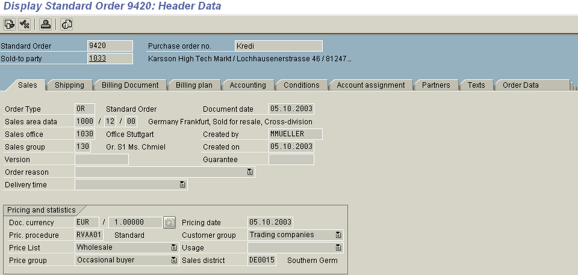
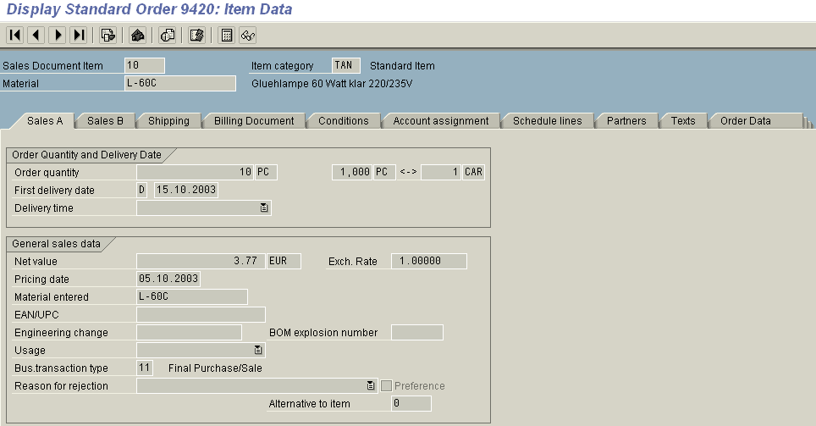
Sales Process - Sales
VA01 – Create sales order VA02 – Change sales order VA03 – Display sales order VA05 – List of sales orders

Slide 58


Sales Process - Delivery
Shipping process begins with Outbound
Delivery document creation
The delivery can be created with / without reference to a preceding document (order), but in general it is always created with reference
Delivery document has header & item level data. The schedule line data of the sales order forms the part of item level data
The delivery document control, supports and monitors all sub-process of the shipping processes like,
Picking (optional)
Packing (optional)
Planning & monitoring of transport (optional)
Posting good issue
Posting goods issue changes quantity as well as value of the stock (for valuated materials) and is reflected in relevant accounts

Slide 59
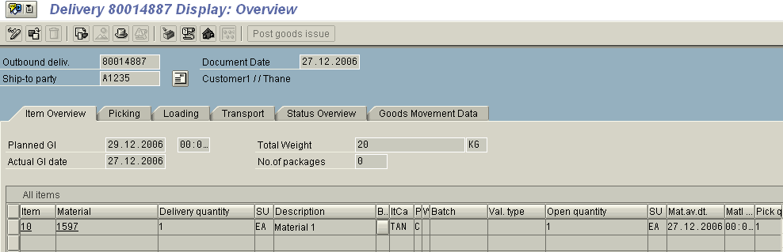
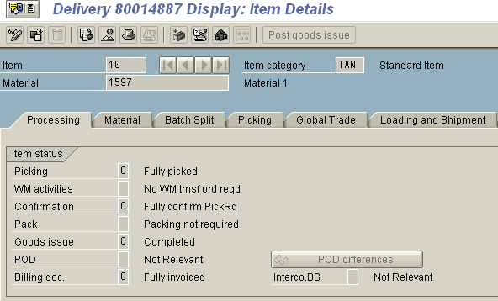
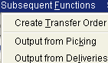
Sales Process - Delivery
Post Goods Issue
VL01N – Create delivery VL02N – Change delivery VL03N – Display delivery

Slide 60

Sales Process - Billing
Billing documents are always created with reference either to order or delivery. Delivery items as well as order items (products & services) can be references for a billing document.
Billing documents have only internal number range assigned, it is not possible to assign external number range.
Invoice
_
_
_
_
_
Billing document has header and item level data and forms the basis as data source for financial accounting
Billing document creation updates G/L accounts and carries out
debit posting on customer receivables account
credit posting on revenue account

Slide 61
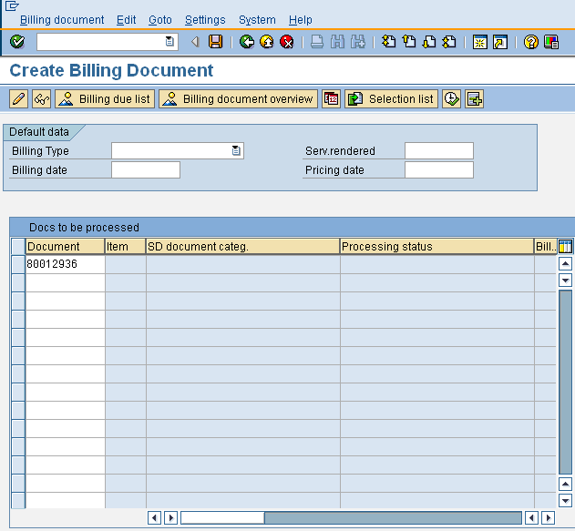
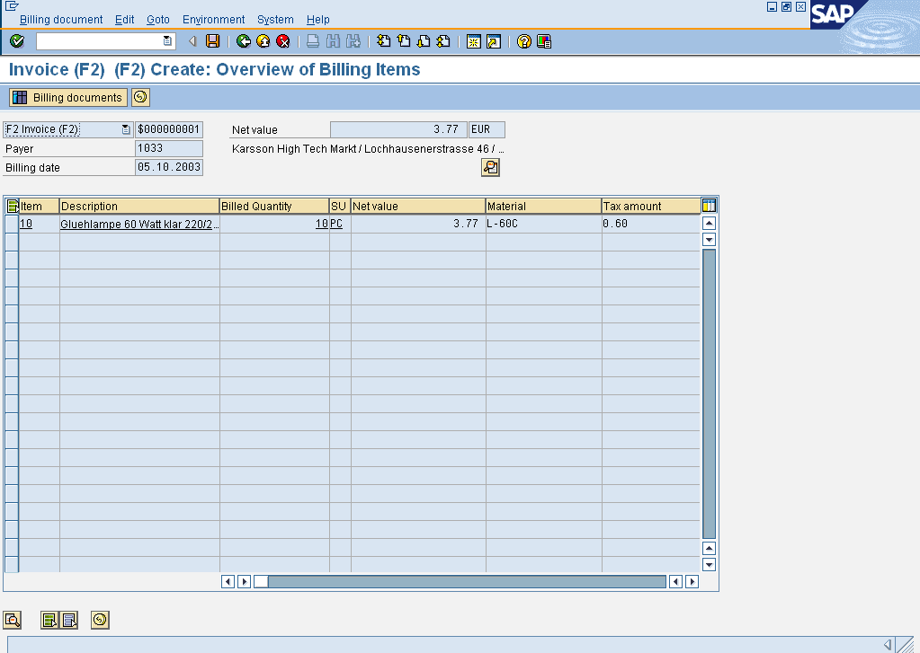
Sales Process - Billing
VF01 – Create Billing Document VF02 – Change Billing Document VF03 – Display Billing Document VF04 – Process Billing Due List VF11 – Cancel Billing Document
Billing document can only be created with reference to either a Delivery or a Sales Order

Slide 62

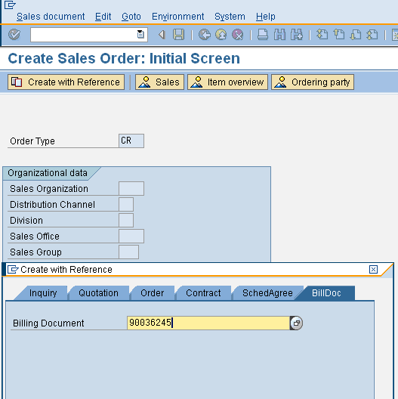
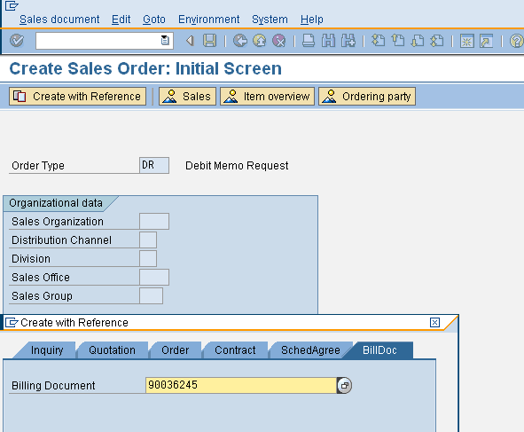
Sales Process – Credit/Debit Memo
Credit and Debit Memos are first created as Sales Documents (Credit and Debit Memo Requests) and then are Invoiced through (Credit and Debit Memos).
It is possible to create these independently or with reference to previous
transactions.
It is possible to apply a Billing block on Sales Orders – generally used for Credit Memo Request Orders

Slide 63

Sales Process - Tracking
Documents in sales process are linked
to each other through Document flow. You can access history and current status of the sales process at any time
All preceding and succeeding documents can be displayed.
Reports
VA15 – List of inquiries VA05 – List of sales order
VF05 - List of Billing document
VA25 – List of quotations VL06F – List of deliveries

Slide 64
LetMe
Input | Expected Result
Call Transaction VA03 or navigate to menu path Logistics→Sales&Distribution→Sales→ | ‘Display Sales Order : Initial screen’ appears
Press enter or click on the Green tick | Display zzz Sales Order xxx : Overview screen appears. Check the Header information such as Required Delivery Date, Delivering Plant, Payment Terms, Sales Area and Item details such as materials, quantity, description, Item Category
Navigate to Ordering Party tab | Check Customer Material Number and description
Navigate to Goto→Header→Sales | ‘Display zzz Sales Order xxx : Header Data’ screen appears. Check Administrative information such as Order Type, Created by & on,
Go back and Navigate to Goto→Item→Sales | ‘Display zzz Sales Order xxx : Item Data’ screen appears Check Material Entered & Usage

Slide 65
LetMe
Input | Expected Result
Navigate to Goto Conditions tab | Check prices, discounts, taxes. See pricing Analysis.
Navigate to Goto Schedule lines tab | Check Delivery Dates & Quantity
Navigate to Goto Partners tab | Check default partners
Navigate to Goto Texts tab | Check which texts have been copied & from where
Navigate to Environment→Partner→Display Sold-to party | Check customer details in General Data & Sales Area Data
Go back and Navigate to Environment→Display Material | Check the details on Sales views and Basic data views
Go back 3 times | You are now at Display Sales Order : Initial screen
Navigate to Sales Document→Issue Output to→ | Check the print preview of Order Acknowledgement
Go back. Click the document flow button. | All the preceding * subsequent documents will be listed. Display each of these.

Slide 66
Tips and Tricks
Verkauf is a German word for Sale. Most SD transactions codes & tables start
with ‘V’.
If a transaction ends in 1 (01,11, 21, etc) it will always be a CREATE transaction.
E.g. VA01 – Create Sales Order, VA21 – Create Quotation, etc.
If a transaction ends in 2 (02, 12, 22, etc), it will always be a CHANGE transaction
E.g. VA02 – Change Sales Order, VA22 – Change Quotation, etc.
If a transaction ends in 3 (03, 13, 23, etc), it will always be a DISPLAY transaction
E.g VA03 – Display Sales Order, VA23 – Display Quotation, etc.
Area Menus such VA00 (Sales), VL00 (Shipping) , VF00 (Billing), VS00 (Sales Master Data), VT00 (Transportation) provide access to only to specific areas.
You can show the keys for values in the drop down option. To do this chose Customizing local layout→ Options→ Expert and then check the check box ‘Show keys in all drop downs.
Whenever you create new entries in Customizing, always remember to copy a SAP standard entry and then modify it. (The system copies several pieces of information in the background.)

Slide 67
Additional Info
Choose a task from the SAP Easy Access workplace menu. With
this menu, you can easily find your application without having to memorize transaction codes. Alternatively enter a transaction code in the command field. With transaction codes, you can go directly to a task without having to navigate through several different menus.
To go to command window using key board press keys Ctrl+tab
To generate a new session enter /o in the command window
To call a transaction in new window enter /oxxxx in the command window
To call a transaction and skip initial screen, enter /”xxxx in the command window
To delete a session enter /i
To end a session enter /n in the command window
To log off with prompt enter /nend in the command window
To log off an close all open session windows without prompt enter
/nex in the command window

